Slide 1
EIT x Soft Robots: project update
Week of Monday 23/08/2021

Slide 2
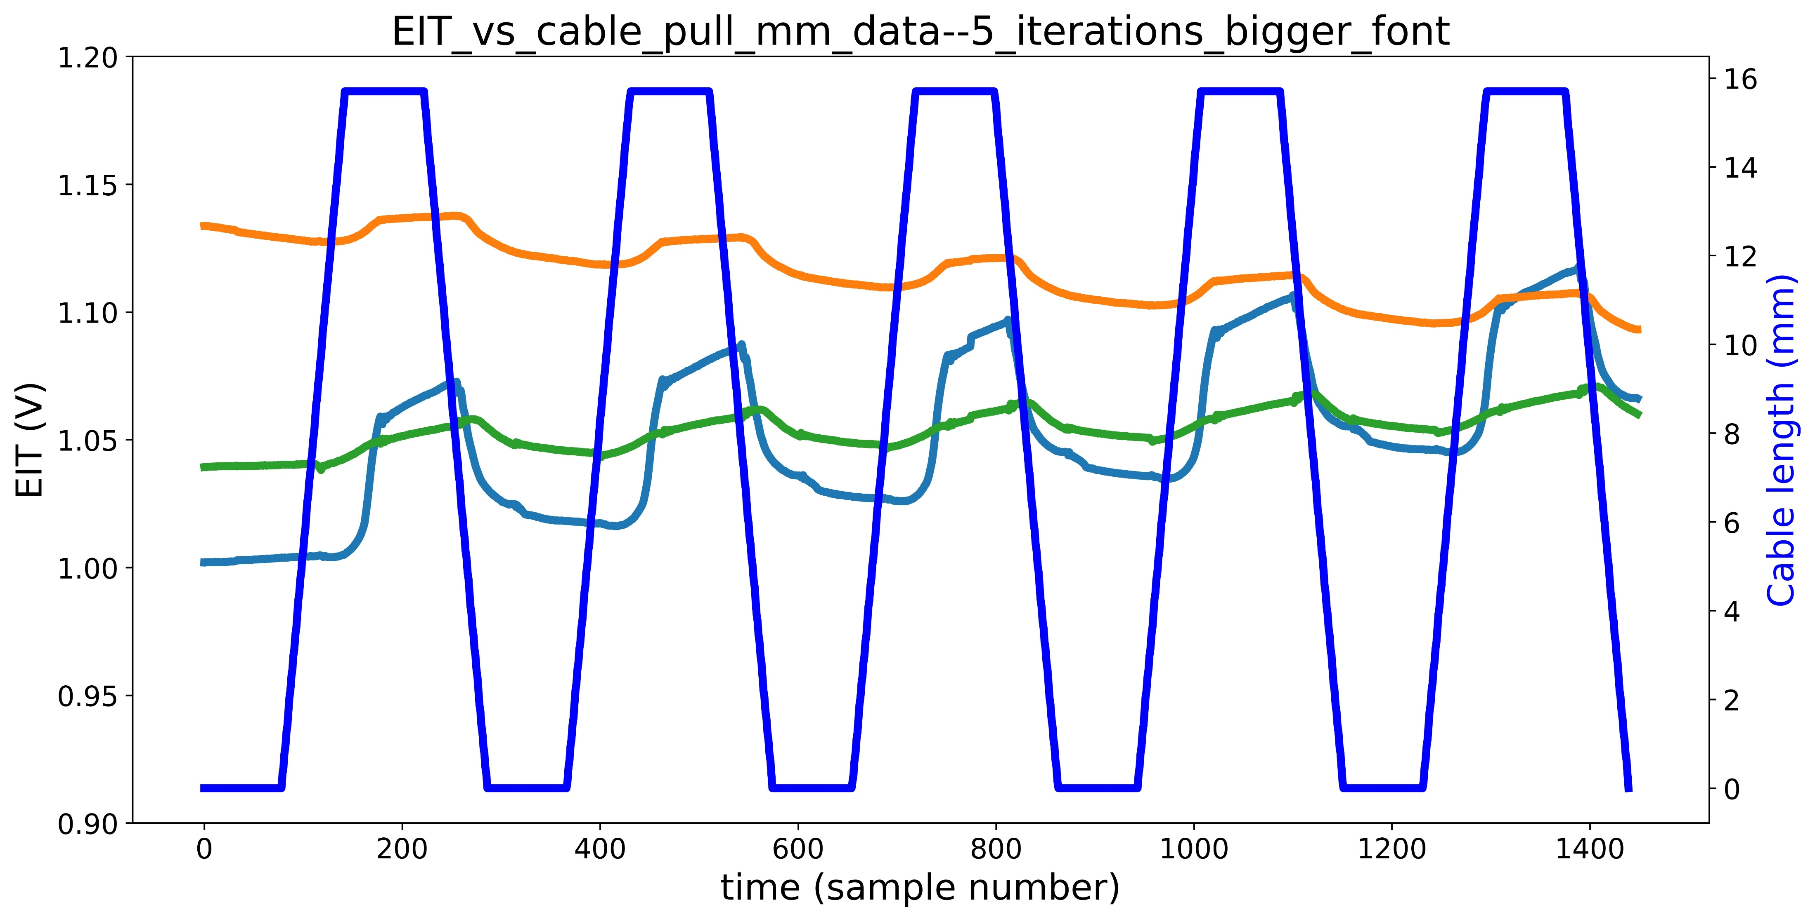
Copper wire actuator data – clarifications/investigations
Drift caused by eroding electrodes/air bubbles
EIT vs cable pull mm data
1
2
3

Slide 3
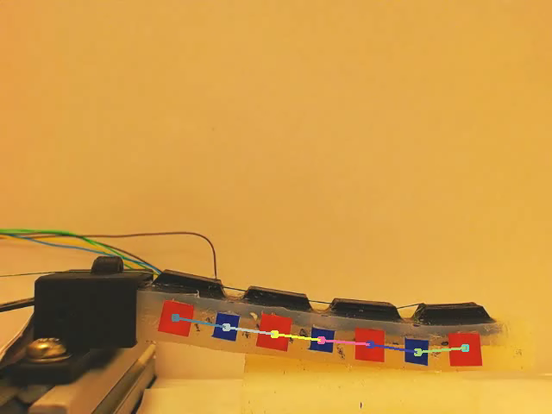
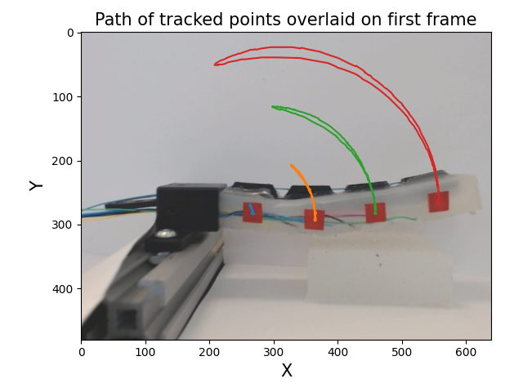
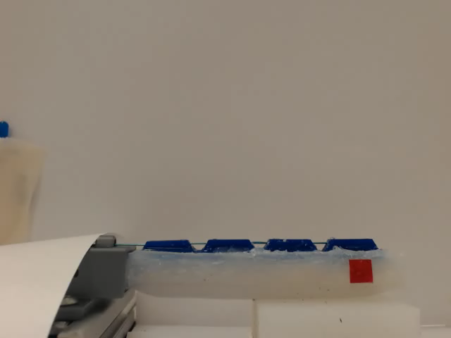
Computer vision progress
Units are pixels

Slide 4
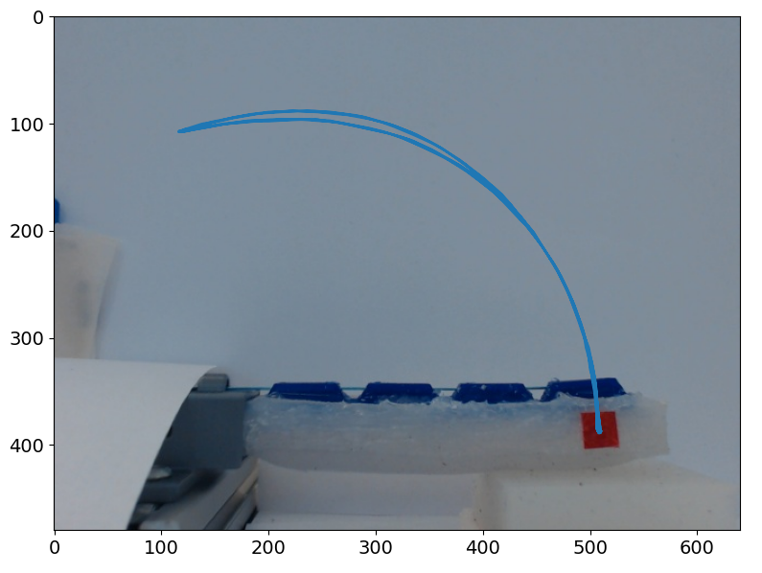
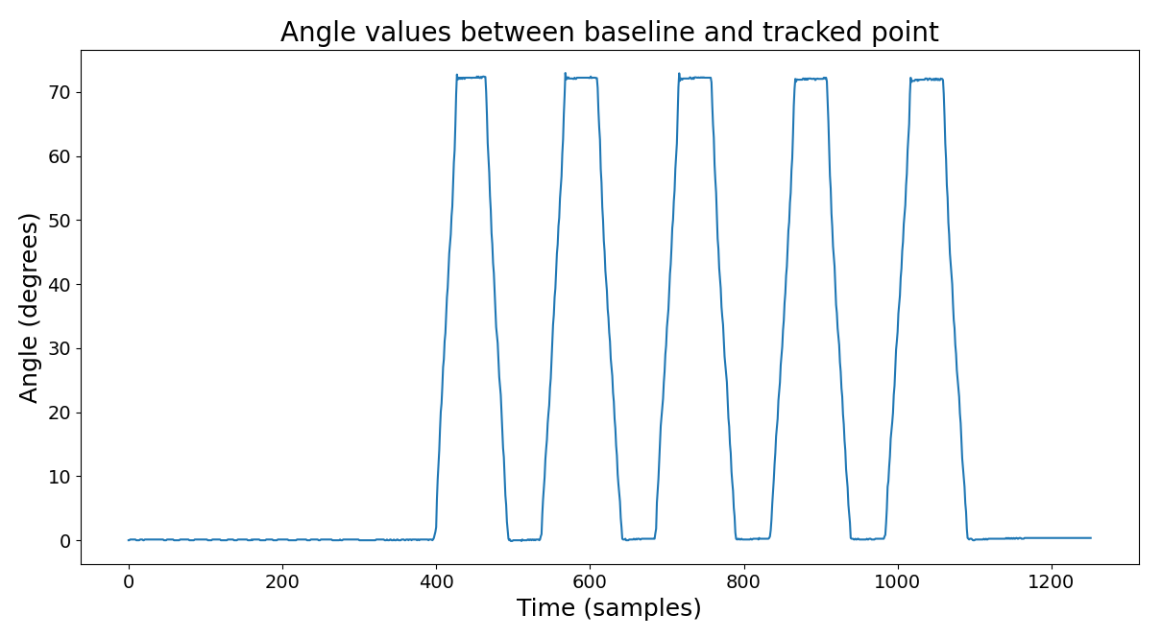
Ground truth acquisition: 1 angle
opp
θ
adj

Slide 5
TODO
Questions
Refine pipeline for acquiring data (from DAQ, Arduino, and webcam)
Refine pipeline for collating and aligning data (must fix Git error)
Feed data into ML script (start simple with linear regression, also develop LSTM)
Actual thesis writing
What changes (if any) are appropriate to my figures to make them suitable for the thesis?
Feedback on thesis structure
What limit is there (if any) on images in the thesis?
Any concrete feedback on the literature review?

